Slide 1

Snmp Trap Generator
- Aniket

Slide 2
Introduction
What is SNMP?
Why is it used?
Snmp Traps.
Nutanix customers using SNMP, Nvidia (Xenoss Monitoring tool), Sutter Health etc.
Notes:
SNMP as it is stated simple network management protocol basically focusing on collecting and monitoring the information about the managed devices on connected network.

Slide 3
Problem Statement
Snmp Traps cannot be consumed easily by monitoring tools.
No classification for the traps.
Add traps for all new alerts every release.
Make the traps more detailed.

Slide 4
Snmp Trap Generator
Dynamically generate SNMP traps and publish in Nutanix MIB.
Parse the existing Alert json/Protobufs to get trap list.
Changes made in trap sending code to send correct SNMP trap.
Make sure the traps are not duplicated/changed across releases.
Notes:
MIBs describe the structure of the management data of a device subsystem;

Slide 5
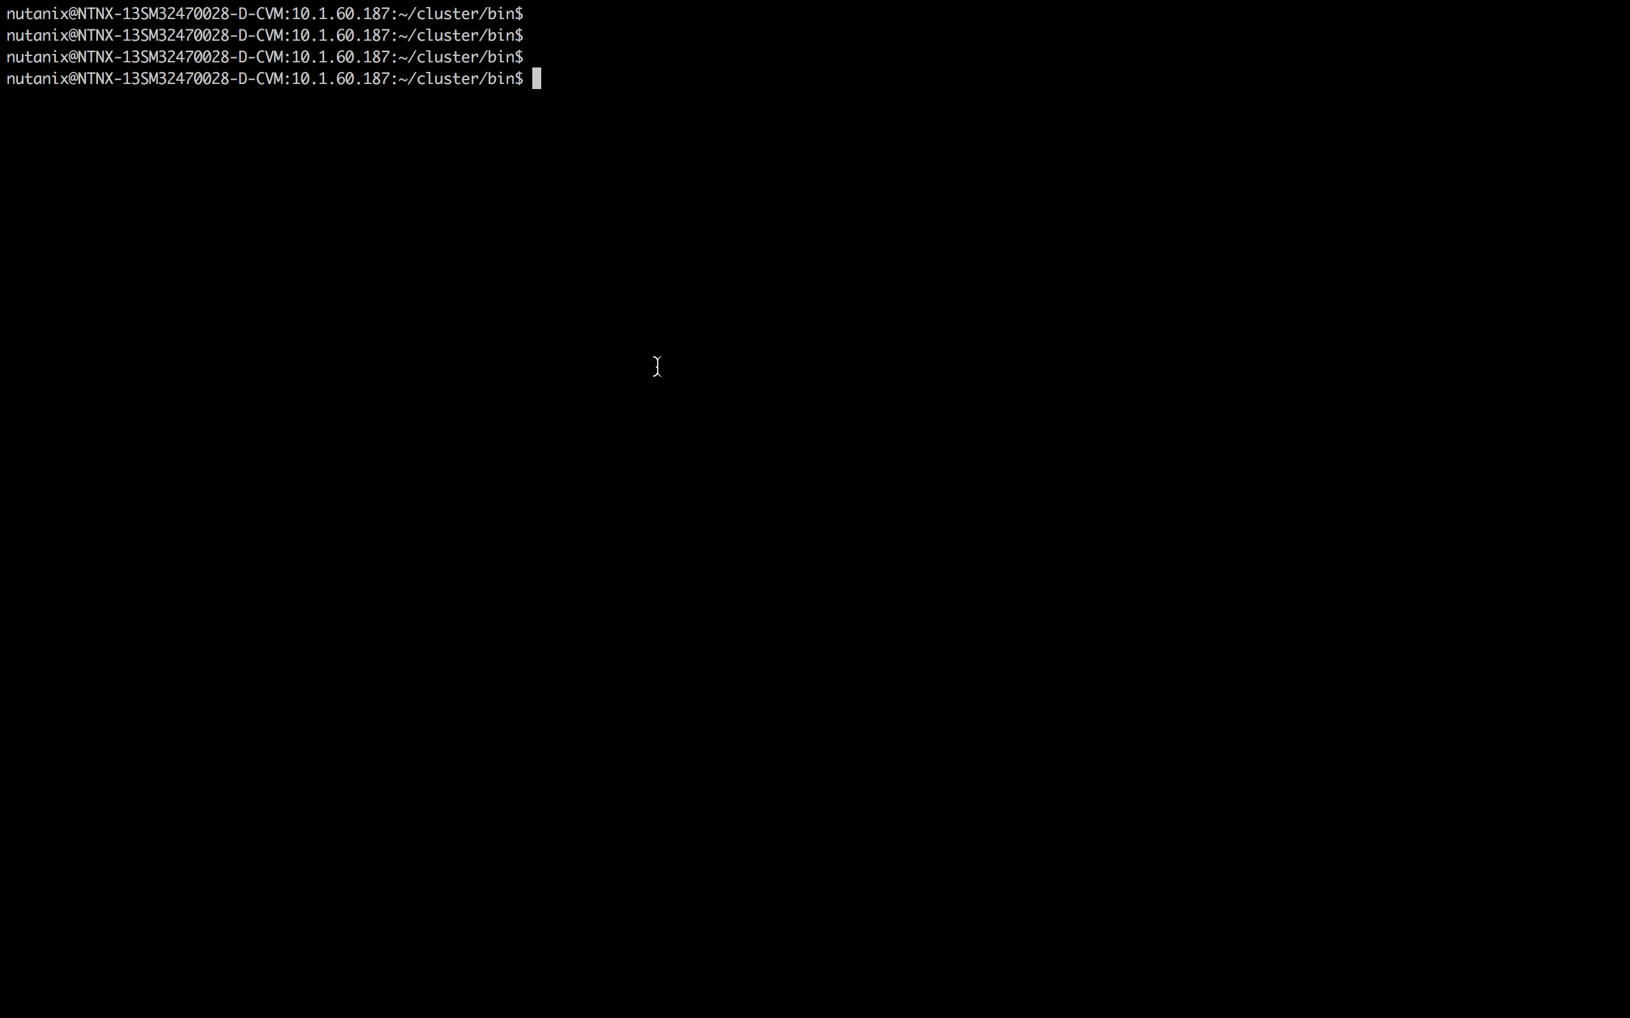
Brief Demo

Slide 6
Q & A

